Slide 1

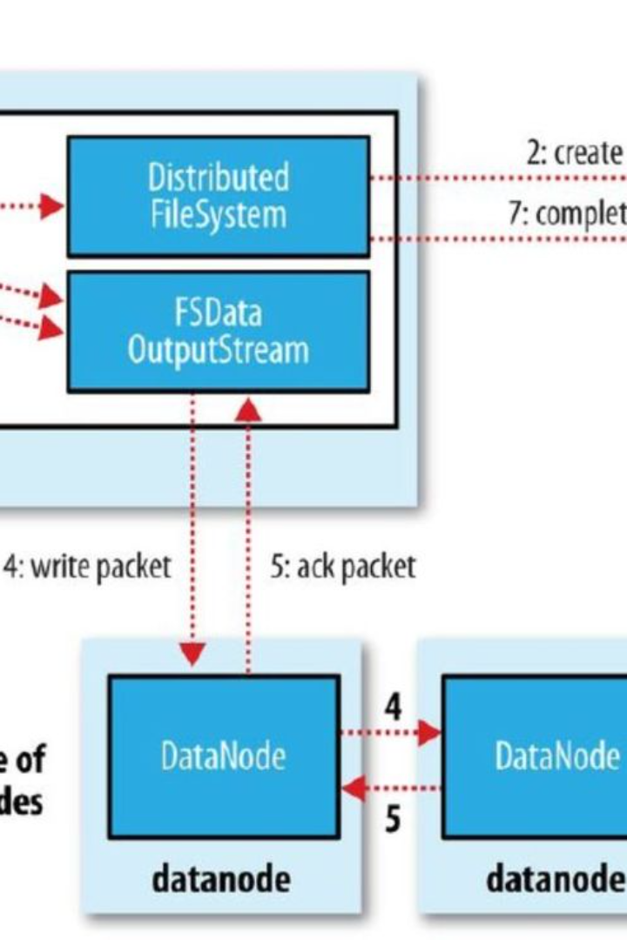


Command to Create a Directory Structure in HDFS
When working with Hadoop Distributed File System (HDFS), it's essential to understand the command for creating a directory structure. The 'hdfs dfs -mkdir' command is used to accomplish this, allowing you to organize your data efficiently within HDFS.
by Bhavya Kesi Reddy

Slide 2

The syntax to create a directory structure in HDFS is by using the command ```bash hdfs dfs -mkdir ```.
This command is essential for setting up the initial directory structure for data storage in HDFS.
When using this command, the user must ensure they have write permissions on the parent directory.
It is recommended to use a consistent naming convention and organize directories based on the data's purpose or source.

Slide 3

The command hdfs dfs -mkdir /user/hadoop/data is used to create a new directory within the Hadoop Distributed File System (HDFS).
It specifies the location where the new directory, in this case, /user/hadoop/data, should be created.
If the directories in the specified path do not exist, they will be automatically created.
It's important to note that the user running this command must have appropriate permissions for the parent directory.

Slide 4

This command is essential for creating a directory structure in HDFS. By specifying the directory path, users can determine the exact location where the directory should be created, ensuring efficient organization of data within the Hadoop Distributed File System.

Slide 5

Note: If the parent directories in the specified path do not exist, they will be created automatically.
Automatic creation: Parent directories are automatically created if they do not exist.
Convenience: Simplifies the process of creating nested directories.
Error prevention: Ensures that the specified directory path can be created without manual intervention.

Slide 6

Permissions
Write permissions: The user running the command must have write access
Parent directory: The user must have write permissions on the parent directory
Access control: Proper access control must be in place to ensure security

Slide 7

Error handling: If the directory already exists, an error will be thrown.
Directory already exists: An error will be thrown when attempting to create a directory that already exists.
Exception message: The error message will indicate that the directory already exists in the specified location.
Resolution: Resolve the error by specifying a different directory name or using the existing directory as needed.

Slide 8

Use Case
This command is essential for creating the foundational directory structure for data storage in HDFS. It is commonly used during the initial setup phase of HDFS to organize and manage data effectively.

Slide 9

Consistent Naming Convention
Organize Based on Data's Purpose or Source
Always use a consistent naming convention for directories to ensure clarity and organization.
Organize directories based on the data's purpose or source to facilitate easy data management and retrieval.

Slide 10

Additional Options
Set Permissions: Allows setting specific permissions for the created directory.
Replication Factor: Adjusts the number of times the data is replicated.
Other Properties: Include options for encryption, access control, and storage policies.

